Slide 1

Data Collection
Quickwrite:
What are the different ways we can measure someone’s height and how can we display this data?
Notes:
hook

Slide 2
Collecting Heights
Measure your heights
Record them on the board
We will use this data later in the lesson
Notes:
hook

Slide 3
Lesson objective
By the end of this lesson you will be able to;
Display data in a stem and leaf plot
- Read information from stem and leaf plots
Notes:
Lesson

Slide 4


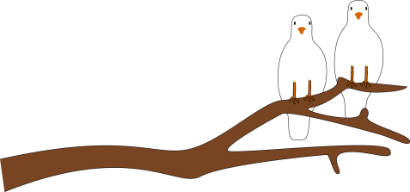
24
7
30
Date
Stem and Leaf Plot
EQ- How can I represent data in a stem and leaf plot
Put the following data into a stem and leaf plot
5, 6, 7, 8, 8, 10, 11, 11, 12, 15, 16, 17, 21, 23
Title
Stem
Leaves
Key: 2|3 = 23
0
1
2
5 6 7 8 8
0 1 1 2 5 6 7
1 3
5
Notes:
Non ordered data

Slide 5
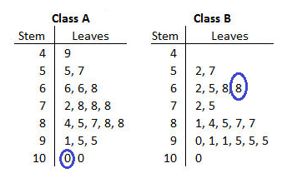
What does the circled numbers represent?
Key: 5|2=52
100 68
Notes:
Check for understanding

Slide 6
24
7
30
Date
Stem and Leaf
EQ – How can I represent data in a stem and leaf plot
Putting data into a Stem and Leaf Plot
Step 1: Create your key and draw up your stem and leaf plot
Step 2: Put the data into the stem and leaf plot
Step 3: Rewrite the stem and leaf plot with the numbers in order
5
Notes:
Lesson objective (EQ)

Slide 7
Put the following data into a stem and leaf plot
5, 12, 35, 23, 22, 26, 32, 18
Data
Data
Key: 1|2=12
Key: 1|2=12
0
1
2
3
5
2 8
2 6
5 2
0
1
2
3
5
2 8
2 3 6
2 5
The data has to be in ascending order
Notes:
Guided practice

Slide 8
Practice
Pg 195 in the Dwyer 7
Exercise 14.6
Notes:
Independent practice

Slide 9
Heights into stem and leaf
The heights recorded at the start of the lesson, put them into a stem and leaf plot.
This is your exit pass!
Notes:
Closure

